Slide 1
Welcome lecture
By: israa sabri

Slide 2
Programming and Problem Solving
Course subject: Programming and Problem Solving
Theoretical 2 hours (Sunday)
2 hours(Tuesday)
Practical ( electronic lab.) : 3 hours (Saturday)
Total mark: Theoretical mark+ Practical mark+ quizzes+ interaction in a lecture + doing the assignments .

Slide 3
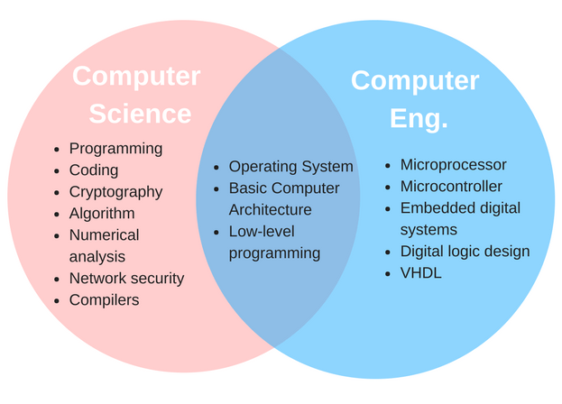
computer engineering vs computer science

Slide 5
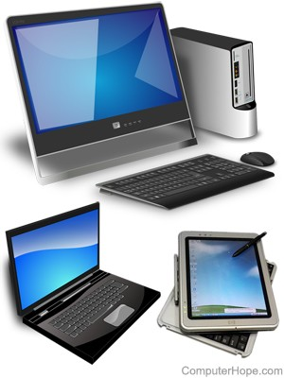
What is computer?
Computers are electronic devices that accept data (input), process that data, produce output, and store (storage) the results.

Slide 6
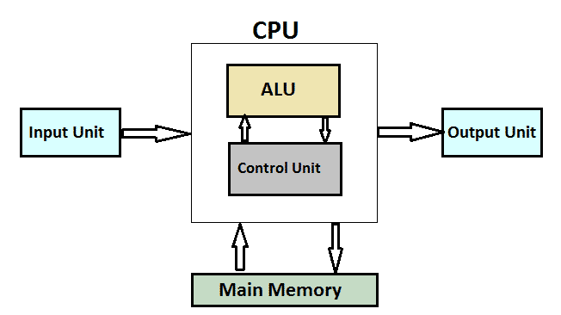
Computer System

Slide 7
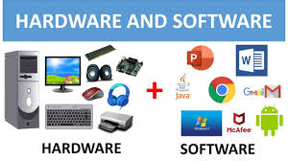

Slide 8
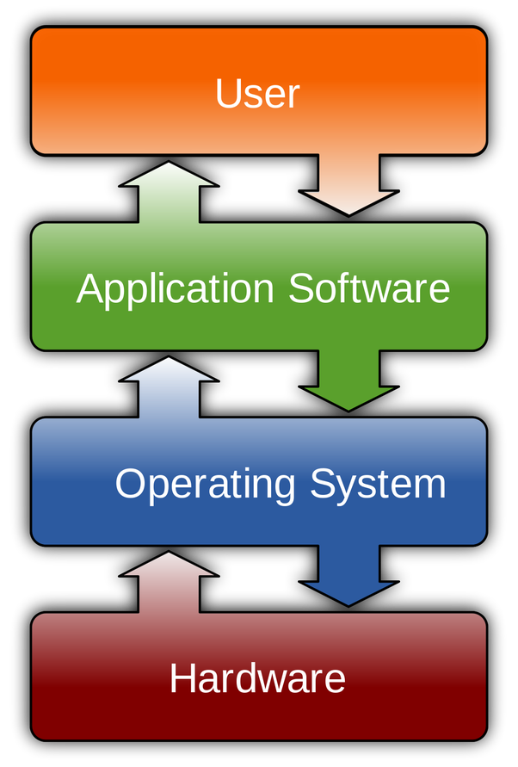
Types of software

Slide 9
Thank You

